Slide 1

ENTROPY COMPUTING TO DETECT DDOS ATTACK.

Slide 2

Introduction
Distributed Denial of Service (DDoS) attacks pose a significant threat to servers on the internet, creating disruptions by overwhelming them with a massive influx of traffic. Detecting such attacks can be challenging due to their elusive nature, often occurring when a large number of users access the target simultaneously. In this context, entropy computing offers a promising approach to discern patterns within network traffic and identify anomalous behavior associated with DDoS attacks. By leveraging entropy-based analysis, we aim to quantify the accuracy of DDoS attack detection, providing insights into the effectiveness of our defensive measures. This presentation explores the application of entropy computing in bolstering server security against DDoS attacks, highlighting its potential impact on mitigating cyber threats and ensuring uninterrupted service availability.

Slide 3

Importance of Detection and Mitigation
Detection and mitigation of DDoS attacks are crucial for maintaining internet stability and service availability. Rapid detection allows for swift response, preventing disruptions and ensuring uninterrupted access. Effective mitigation strategies are essential to mitigate financial losses, reputational damage, and legal consequences. Collaboration among stakeholders is vital for staying ahead of evolving threats.

Slide 4

Overview of Entropy Computing
Entropy computing quantifies the randomness or uncertainty in data streams.
It calculates entropy values to measure the unpredictability of data.
In DDoS detection, entropy computing analyzes network traffic patterns.
Anomalies in entropy signify deviations from normal traffic behavior.
Statistical analysis enhances the accuracy of attack detection.
It enables proactive mitigation strategies against DDoS attacks.

Slide 5
Rationale for Using Entropy in DDoS Detection
Using entropy in DDoS detection offers a robust approach by quantifying uncertainty, detecting abnormal patterns, enabling statistical analysis, adapting to evolving threats, ensuring efficiency and scalability, and integrating with machine learning for improved accuracy.

Slide 6
Explanation of Data Collection:
The data for this project was sourced from Kaggle, an online platform hosting datasets for various machine learning and data analysis tasks. The dataset is provided in CSV format and contains more than 500 entries. Each entry in the dataset is labeled as either "DDoS" or "Normal," indicating whether it represents a Distributed Denial of Service (DDoS) attack or normal network traffic.
The dataset is effective for class-based classification tasks, as it provides labeled examples of both DDoS attacks and normal network behavior. This allows for the development and evaluation of DDoS detection algorithms using supervised learning techniques.

Slide 7
Overview of Detection Algorithm:
The detection algorithm employed in this project utilizes entropy computing to identify potential Distributed Denial of Service (DDoS) attacks. Entropy, a measure of randomness or uncertainty in a data stream, is calculated for a sequence of network packet sizes. A higher entropy value indicates a more unpredictable packet size distribution, which may be indicative of a DDoS attack.
The algorithm maintains a sliding window of the most recent packet sizes and computes the entropy of this window at regular intervals. If the computed entropy exceeds a predefined threshold, it triggers an alert indicating a potential DDoS attack. Otherwise, the network traffic is classified as normal.
This approach allows for real-time detection of DDoS attacks based on the statistical properties of network traffic, providing a proactive defense mechanism against malicious activities.

Slide 8
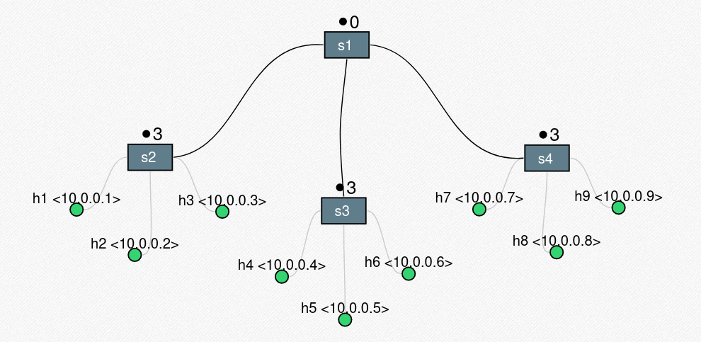
Topology

Slide 9
The role of Flask in your DDoS detection project can be summarized in the following key points: 1. Web Interface Development: Flask allows you to create a user-friendly web interface for configuring DDoS detection parameters such as destination IP address, port, and detection threshold. 2. Request Handling: Flask efficiently manages incoming HTTP requests from users, ensuring proper handling and processing of form submissions and other interactions with the web application. 3. Data Presentation: Flask facilitates the presentation of DDoS detection results to users by rendering HTML templates dynamically. It ensures that the results are displayed in a clear and organized manner for easy understanding. 4. Integration with Backend: Flask seamlessly integrates with the backend of the DDoS detection system, enabling communication between the user interface and the detection algorithm. It orchestrates the flow of data and commands between frontend and backend components. 5. Error Management: Flask handles errors and exceptions gracefully, providing informative error messages to users when issues arise during the execution of the web application. This ensures a smooth and reliable user experience even in the event of errors.

Slide 10
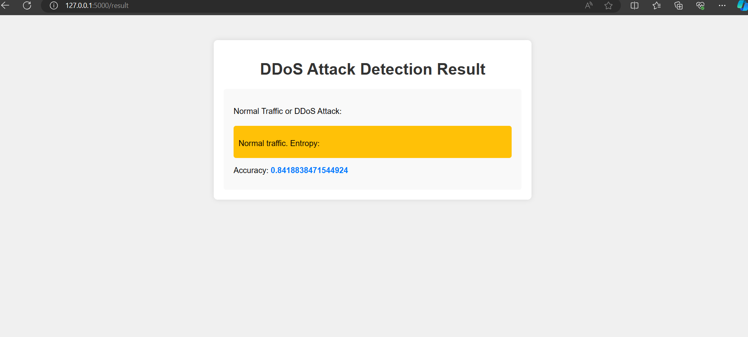

Emulation

Slide 11
Conclusion
We have successfully implemented sample entropy method to detect DDoS attacks. This solution is not only efficient in detection, it has minimal code addition to the controller program and does not increase CPU load in either normal or attack condition.

